Slide 1

Emerging Technology
Pumps And CGM
Children With Diabetes
Charlotte, NC
Sept. 4, 2010
John Walsh, PA, CDE
jwalsh@diabetesnet.com
(619) 497-0900
Advanced Metabolic Care + Research
700 West El Norte Pkwy
Escondido, CA 92126
(760) 743-1431

Slide 2
Disclosure
  Book sales – to all pump companies
  Advisory Boards – Tandem Diabetes, Unomedical
  Consultant – Bayer, Roche Accu-Chek, Abbott, Tandem, Medingo
  Speakers Bureau – Tandem Diabetes
  Instructor – J&J Diabetes Institute
  Sub-Investigator – Glaxo Smith Kline, Animus, Sanofi-Aventis, Bayer, Biodel, Dexcom, Novo Nordisk
  Pump Trainer – Accu-Chek, Animas, Medtronic, Omnipod
  Web Advertising –Sanofi-Aventis, Sooil, Medtronic, Animas, Accu-Chek, Abbott, etc.

Slide 3
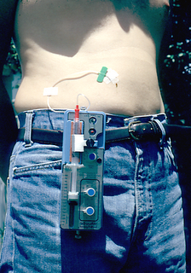
Outline
  Goals
  CGMS
  Special Pump Features
  Pump Settings
  DIA and BOB
  Future Pump Features

Slide 4
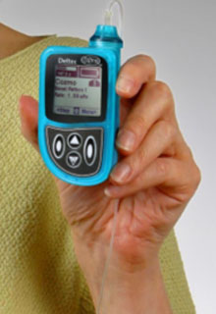
Terms
  TDD – total daily dose of insulin
  (all basals and boluses)
  Basal –background insulin released
  slowly through the day
  Bolus – a quick release of insulin
    Carb bolus – covers carbs
    Correction bolus – lowers high readings
    that arise from deficits in basal rates or
    carb boluses
  Bolus On Board (BOB) – bolus insulin still active from recent boluses, active insulin, insulin on board
  Duration of Insulin Action (DIA) – time that a bolus will lower the BG – used to measure BOB

Slide 5
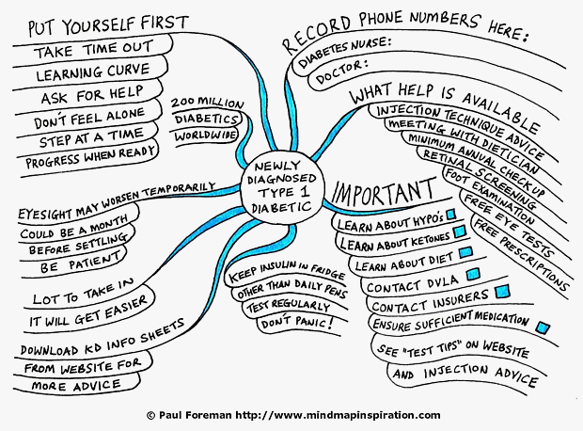

Slide 6
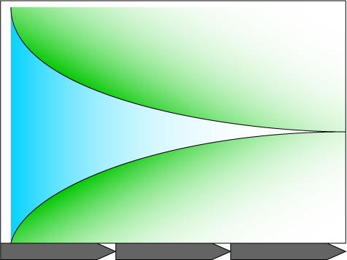
Glucose Goals Differ By Age
The Way To A Closed Loop
I
n
s
u
l
i
n
D
e
l
i
v
e
r
y
1922 Insulin & syringes
Age-Appropriate A1c And Meter Goals
Age | A1c | Equivalent Avg. Meter Glucose *
Less than 6 | 7.5% to 8.5% | 168 to 197
6 to 12 | 8% or less | 183 or less
Over 12 | 7.5% or less | 168 or less
Over 19 | 7% or less | 154 or less
AACE: Over 19 | 6.5% or less | 140 or less
1979
Pumps
1983
Pens
2002 Bolus
Calc.
Connectivity
2012 Mini
Closed Loop
Closed Loop
Data Management
2006 CGMs
M
o
n
i
t
o
r
i
n
g
1971 Home Monitors
1926 Clinic Monitoring
* If only premeal readings are done, meter average will be lower than above.
HCP
Self Management
Automation
Adapted courtesy Roche/Disetronic

Slide 7
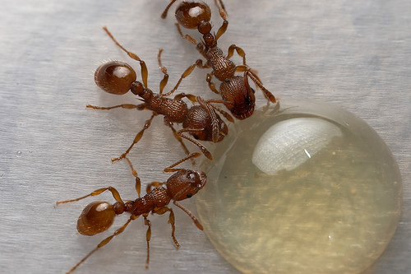
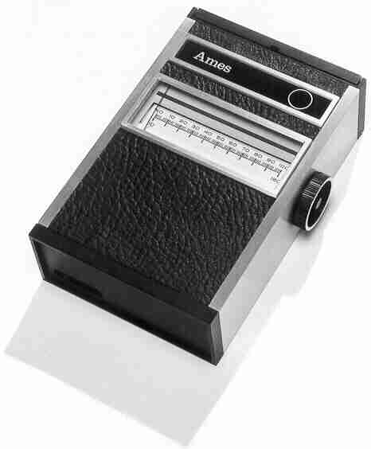
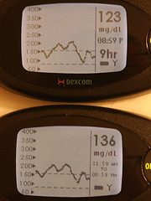
Progress In Monitoring
1300 BC
1971 AD
2010 AD

Slide 8
What If There Were A Pill...
...that:
Decreased amount of time spent high
Decreased amount of time spent low
Warned you of impending highs and lows
Thanks to Dr. Grazia Aleppo

Slide 9

CGM

Slide 10
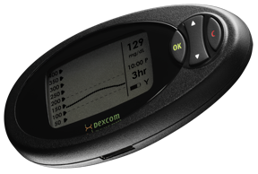
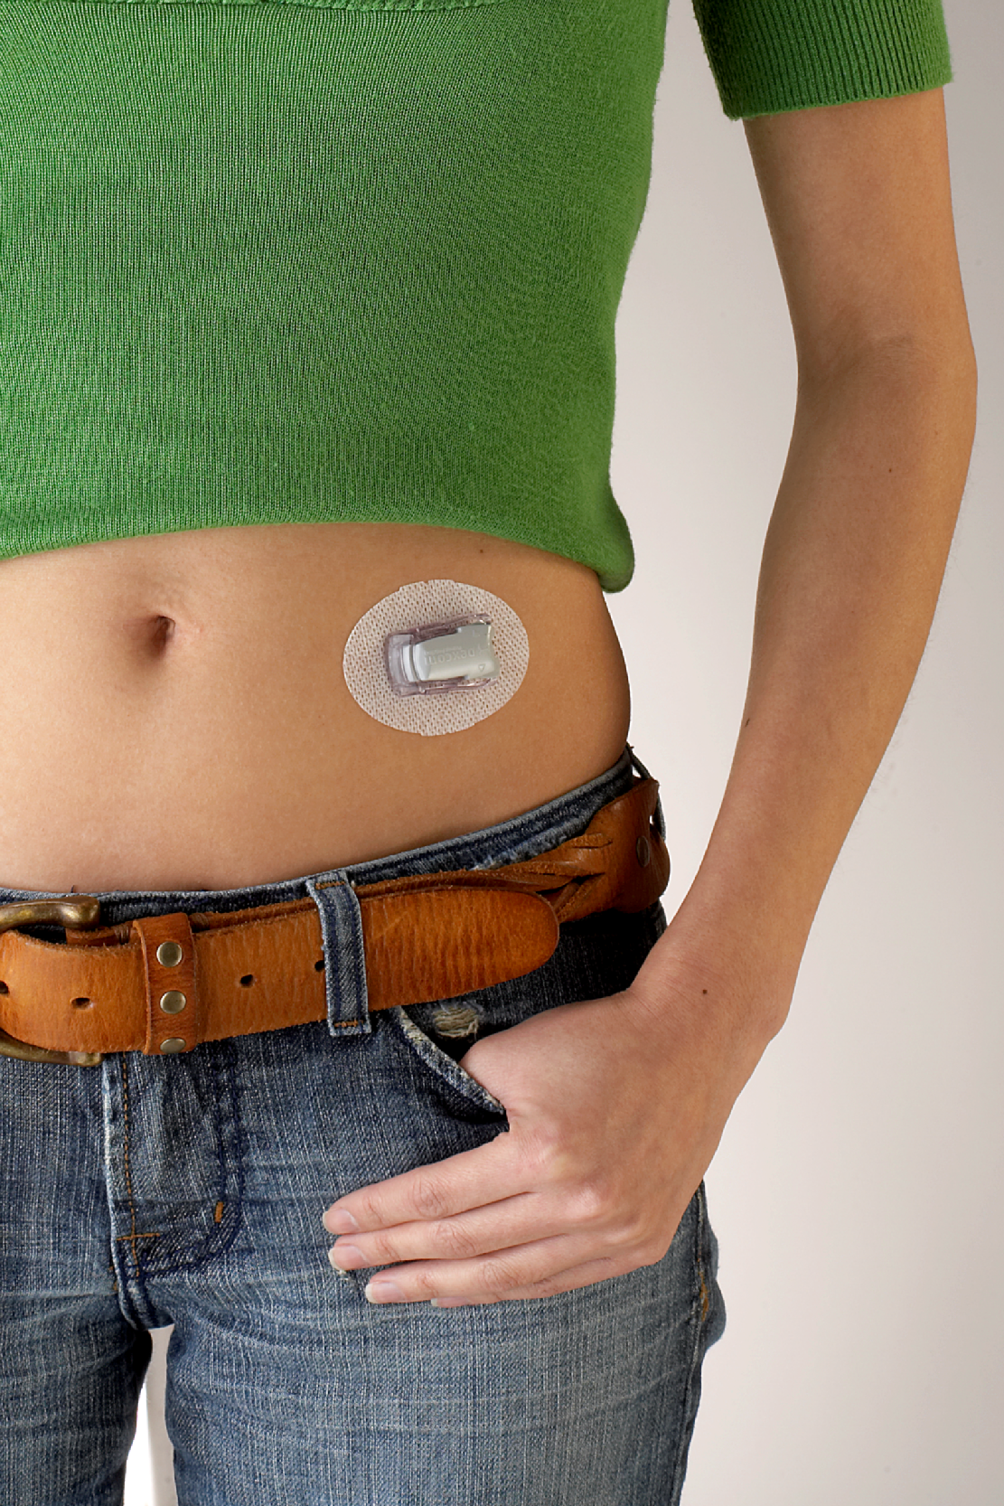
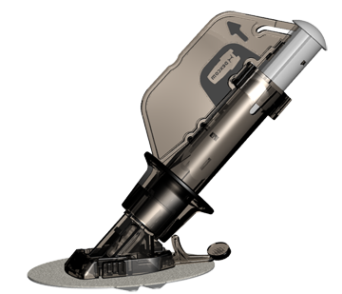

Components
Sensor
Receiver
Transmitter
Notes:
The transmitter wirelessly sends glucose information collected by the sensor to the receiver. Once you insert the sensor, you will snap the transmitter into the sensor pod using the transmitter latch
The transmitter is used for multiple sensor wear periods
10
SEVEN® User’s Guide. San Diego, CA: DexCom; 2007.

Slide 11
Why CGM Helps
Short Term Benefits
  Minimize extreme BGs – tracking and trending minimizes extremes
  Immediate feedback for what each meal/snack/exercise does – behavior mod made easy
  Know the direction you’re going
  Fingersticks become more useful

Slide 12
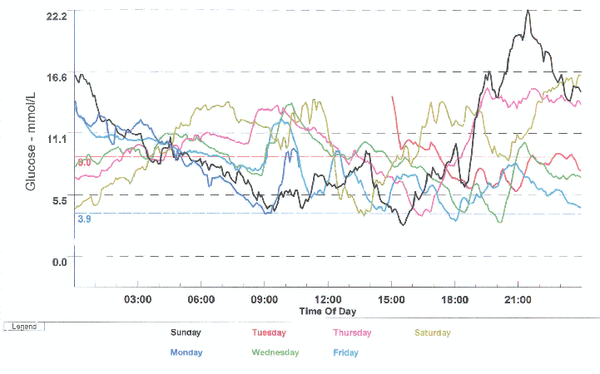
Why CGM Helps
Long Term Benefits
  See your patterns
  Test and tune basals,
  CarbF, CorrF
  Avoid night lows and hypo unawareness
  Peace of mind from fear of lows

Slide 13

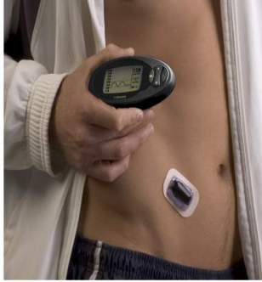
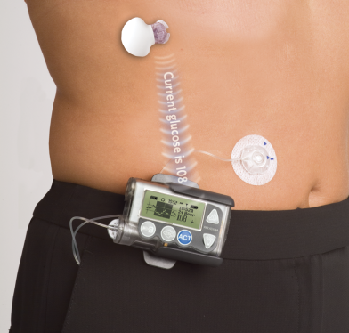
Systems
Abbott FreeStyle Navigator®
DexCom™ SEVEN® PLUS
Medtronic MiniMed Revel® REAL-Time*
* Medtronic Guardian® REAL-Time and I-Port also available.
Notes:
This slide shows the 3 CGM devices that are currently approved for use in the US
13

Slide 14
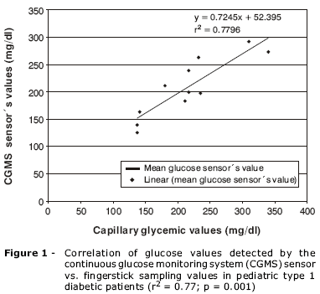
Why Don’t My CGM & Meter Agree?
  “Accurate” meter when control
  solution reads between 106 and
  143 mg/dl (BG = ~120 mg/dl)
  Excellent meter accuracy (+/– 10%)
  = 108 to 132 mg/dl for BG of 120
  CGM is calibrated FROM meter
  CGM accuracy is excellent when
  deviation is +/– 15% or 102 to
  138 mg/dl for BG of 120
  SO....meter may read low (108) and
  CGM high (138) and BOTH be excellent with real BG of 120!

Slide 15
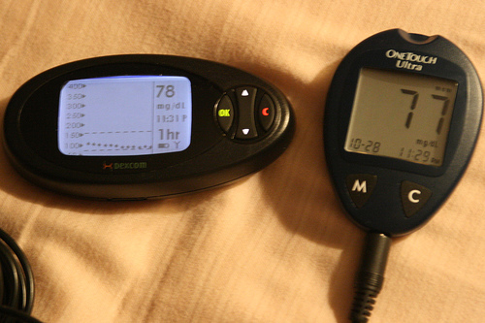
Trends Are Better Than Points
Insight
No clue what to do
Photo courtesy Bernard Farrell

Slide 16

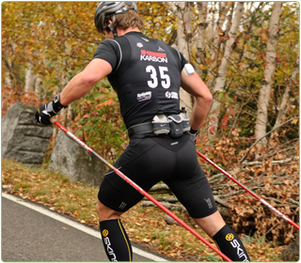
Exercise With Confidence

Slide 17
Experimental CGMs
Invasive and Non-Invasive

Slide 18
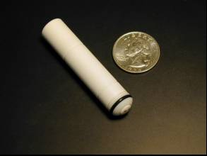
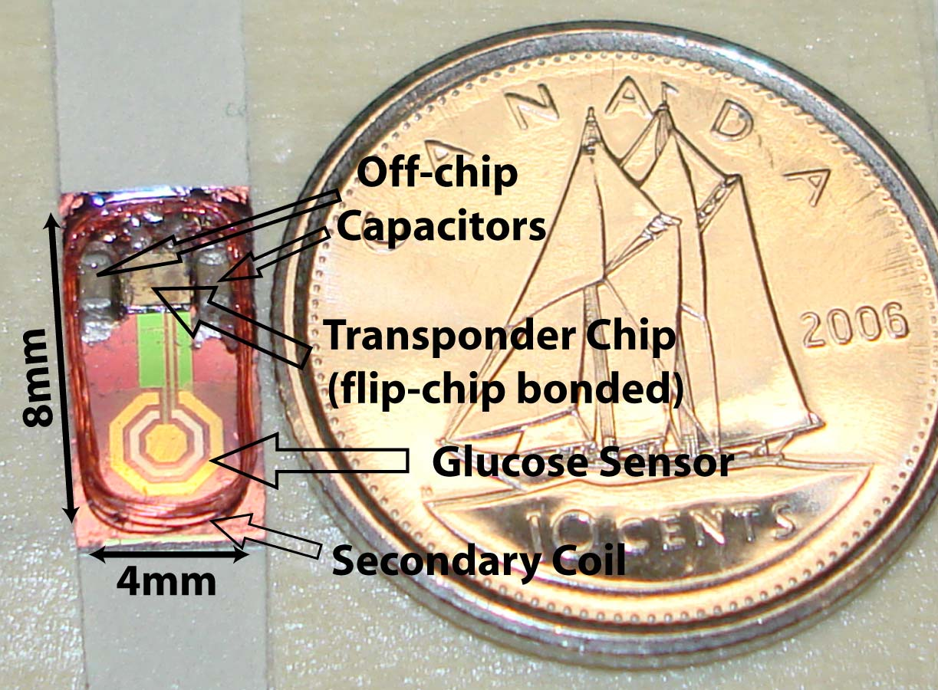
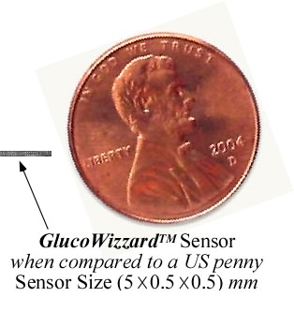

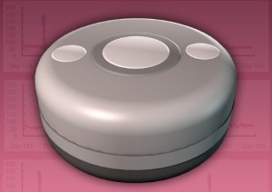
Implanted CGM Systems
Dexcom G1 2004
MicroCHIPS Illume
GlySens

Slide 19

Continuous Osmotic Glucose Sensor
  LifeCare (Bergen, Norway) is working on a CGM to be implanted without surgery
  Currently testing immune system compatibility

Slide 20
Implanted Flourescent Sensors
  Flourescent molecule changes color as glucose rises and falls. LED serves as light source.
  Potential Advantages:
  Small size
  Low power or locally generated power
  Long life

Slide 21
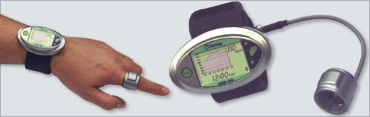
Non-Invasive Optical CGM
OrSense’s NBM-200G uses near infrared light scattering to measure glucose levels.
  Easy to use but likely less accurate than current CGMs
  Tested on over 450 subjects
  Investigational stage
Notes:
21

Slide 22

Non-Invasive Eye Patch CGM
Nanoparticles embedded in hydrogel lens reacts with glucose in tears
Chemical reaction changes color of lens.
Exterior device (glasses) read glucose from color change
Notes:
22

Slide 23
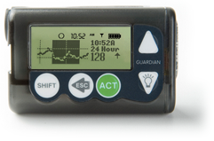
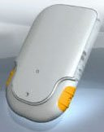
CGM And Pump Choices
CGM:
Dexcom 7+
Paradigm RT
AccuCk Combo
Navigator
Dexcom/Navig.
Pump:
Animas
Insulet
Medtronic
Combo*
?
Tandem
Available
2011
2011
now
2012?
2011?
2012?

Slide 24

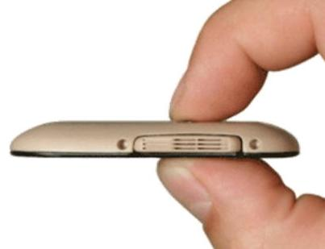
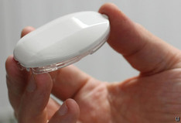
New Pumps
  Tandem 2010
  Solo 2012
  Calibra 2011/12?
  Jewel 2012?

Slide 25
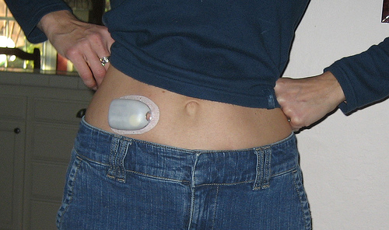
More Patch Pumps
      Roche-Medingo Solo
      Debiotech JewelPump
      Medtronic
      Valeritas V-Go
      Pancreum Beta Wedge
      NiliMEDIX
      Calibra, Medsolve, CellNOVO, Altea

Slide 26
Patch Pump Vs Infusion Set
Patch Pump
  Worn on body
  No external tubing
  Can loosen, leak, be knocked off
Infusion Set
  More site options
  Variety of needle and tubing lengths
  Easy pump removal for showering, sports
  Can loosen, leak, be knocked off

Slide 27
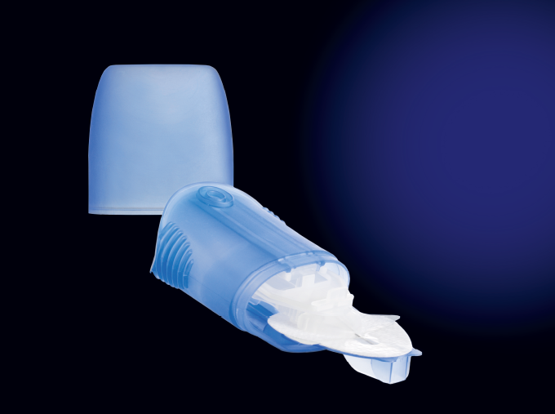
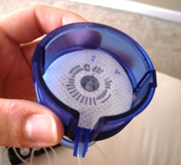
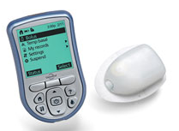
Auto Inserters

Slide 28

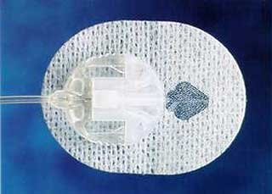
Infusion Sets
Slanted Metal Straight In

Slide 29
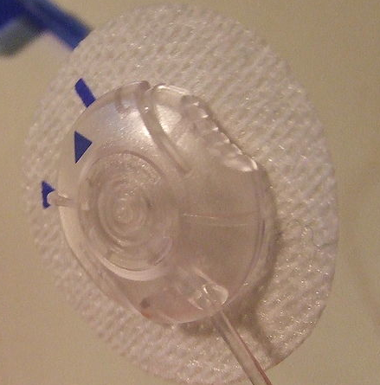
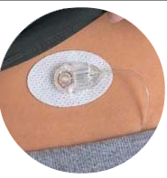
Quick Release Sets

Slide 30
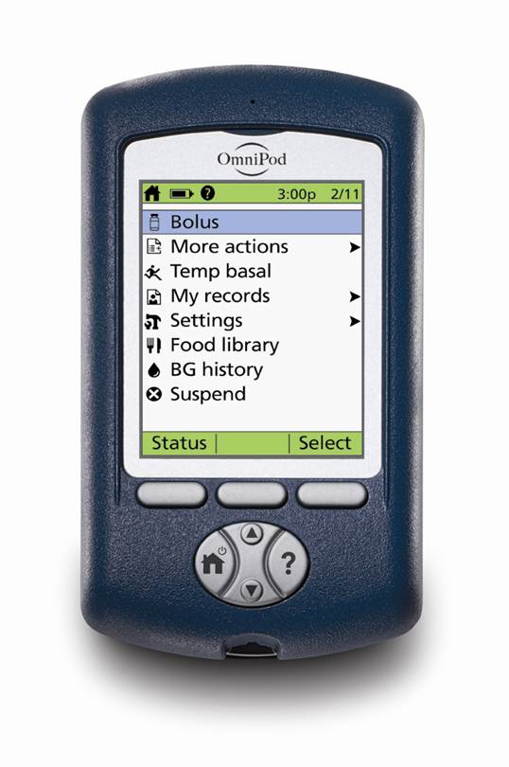
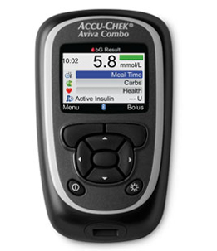

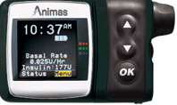
Color Screens
Soon: Tandem, Solo, others

Slide 31
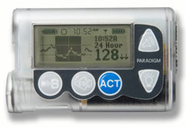
CGM Display

Slide 32
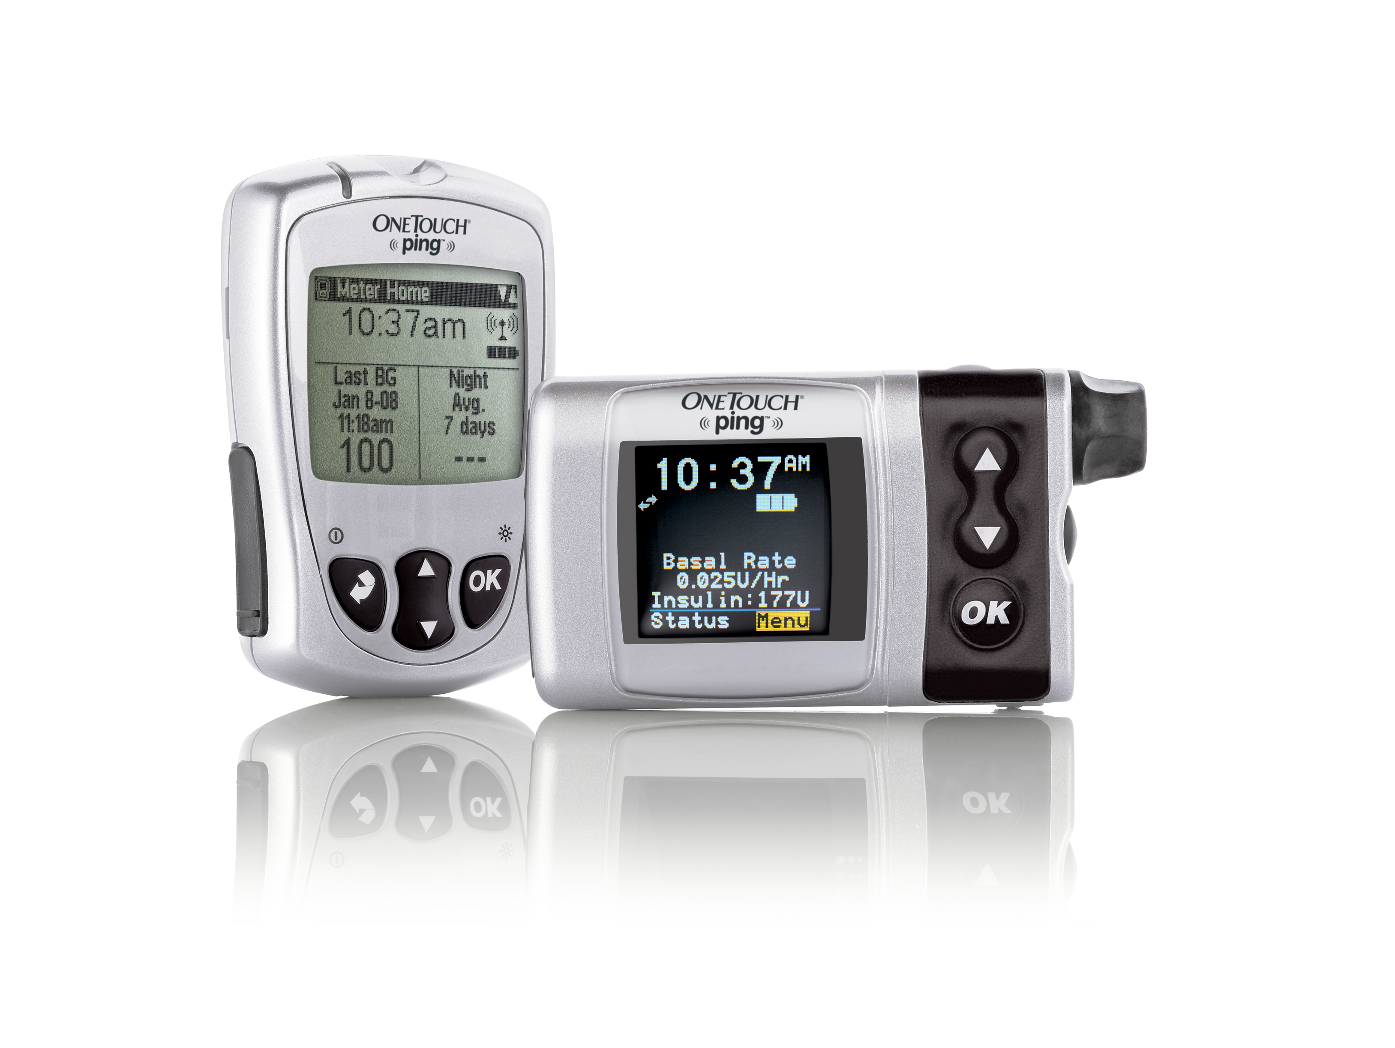
Remote Boluses
  Bolusing from meter/PDA lets pump stay hidden
  Meter sends BG to pump
  Carb bolus, correction bolus, basal remotely controlled by meter/PDA
  Accurate, complete history
Bolus and basal adjustments in Accu-Chek Combo (not yet FDA approved)

Slide 33
Combo Boluses – Part Now, Part Later
  DON’T USE for most meals
  Great for Symlin, low GI carbs,
  hi-protein or hi-fat meals, gastroparesis
  Helps when carb counts or meal timing are uncertain
    Give part of bolus early to get insulin working
    Give rest over time – discontinue if meal has fewer carbs than
    expected. Give 2nd bolus if meal contains more carbs.
  Picky-eater parents love combo boluses

Slide 34
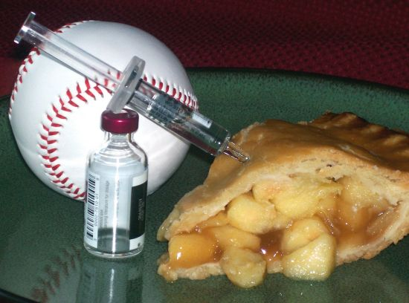
Advanced Carb Counting
  The quick way to keep carbs from raising your glucose
Carb lists in Ping, Omnipod, Spirit/Combo, Tandem, others
Photo courtesy Emily Boller, emilyboller.com

Slide 35

Temp Basal Rates
  Great for:
  Covering exercise
  Handling illness
  Testing new basal rates
  Offseting excess BOB
  Safely “stopping” a pump and restart on time!

Slide 36
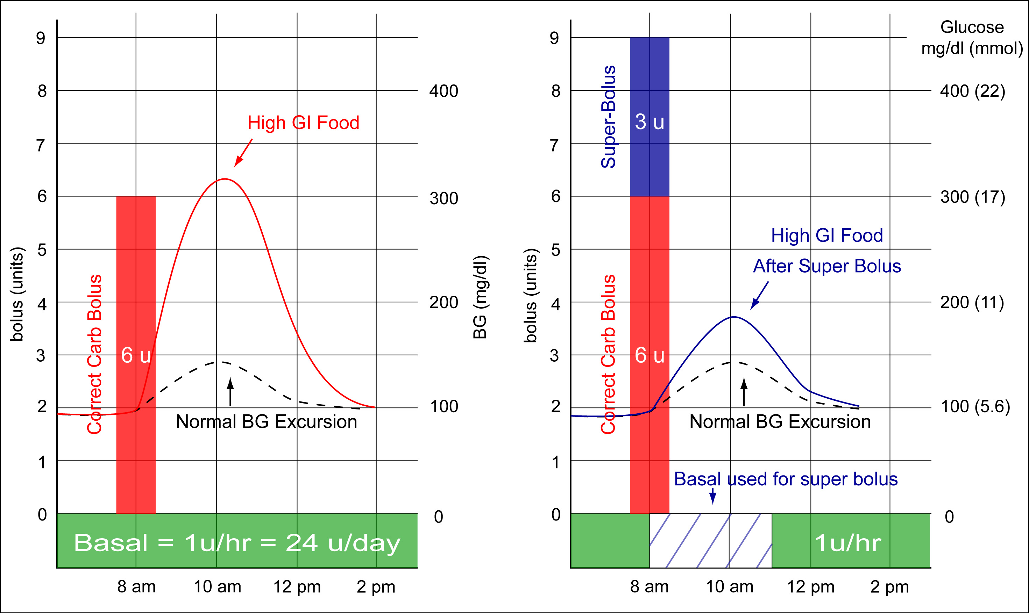
Super Bolus For A High GI Meal
Shifts Basal To Bolus
A Super Bolus helps when eating more than 30 or 40 grams of carb, esp. high GI meals like cereal.
Max carbs/meal =
Wt(lb) X 0.36 ² to stay in control
Future Feature: Super Bolus shifts part of the next 2 to 3.5 hrs of basal insulin into the bolus with less risk of a low later.^{1,2}
¹ J. Walsh: http://www.diabetesnet.com/diabetes_presentations/super-bolus.html September, 2004
² J. Bondia, E. Dassau, H. Zisser, R. Calm. J. Vehí, L. Jovanovic, F.J. Doyle III, Coordinated basal-bolus for tighter postprandial glucose control in insulin pump therapy, Journal of Diabetes Science and Technology, 3(1), 89-97, 2008
Notes:
The Super Bolus borrows basal to pay bolus. By stacking insulin at the time of a bolus, more insulin becomes available sooner. The corresponding reduction in basal delivery prevents hypoglycemia.

Slide 37
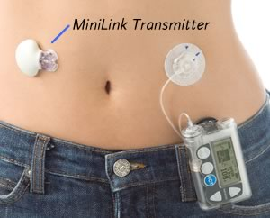
Tips For Success
  Stop lows first
  Find your iTDD – good A1C, stable readings, with
  basal/carb bolus balance
  Set & test basals – do overnight readings stay level?
  Set & test carb boluses – fine-tune premeal BGs
  Lower post meal BGs – give boluses early, low GI foods,
  Symlin, etc.
  Set & test corr. boluses – bring highs down safely
  Enjoy good control or return to #1
Brittle diabetes or frequent highs = wrong doses (usually)

Slide 38
Find Your iTDD
If it ain’t broke, don’t fix it – current doses are great if A1c and avg. meter BG are good with few lows
If not, adjust the current TDD:
    Lower the TDD by about 5% for:
      Frequent lows
      Or highs AND lows IF lows come first
    Raise the TDD, using the iTDD Table on next slide to adjust for high A1c or high meter average
  Keep basal and carb bolus totals balanced
  Avg BG on pumps is 183.9 mg/dl (10.2 mmol) – most need larger TDD.

Slide 39
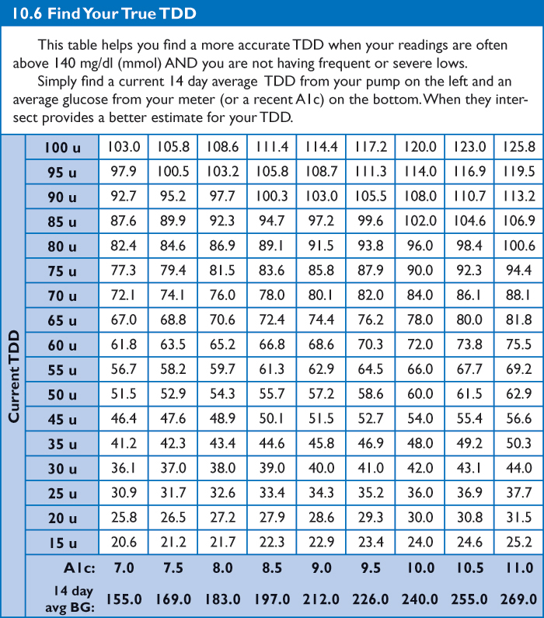
The iTDD Table
  If frequent lows are main problem, lower current TDD by 5% or more
  If frequent highs are main problem, increase current avg. TDD from recent A1c or a 14 day BG average
J Walsh and R Roberts:
Pumping Insulin (5th ed), 2010

Slide 40
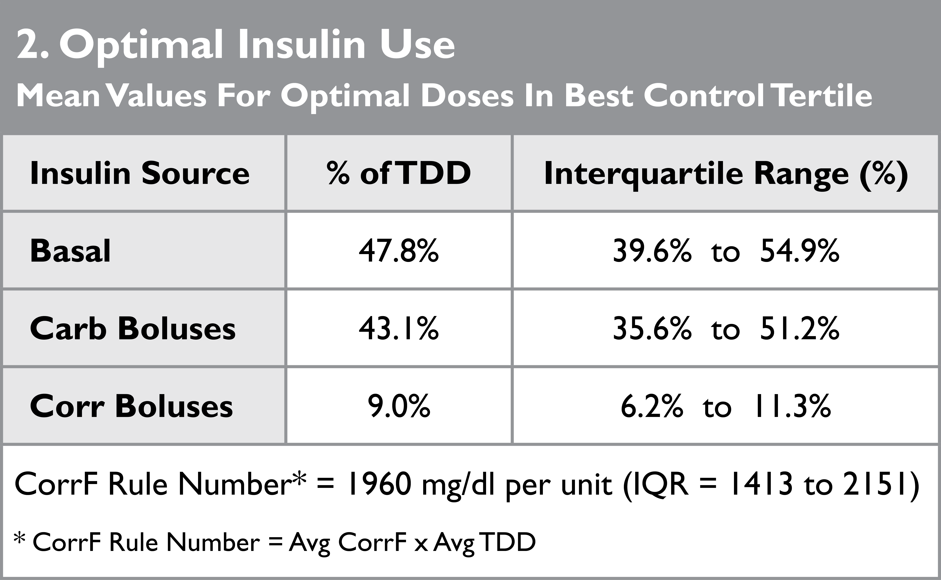
Doses That Successful Pumpers Use
Insulin use from best control tertile (132 of 396 pumps with avg BG of 144 mg/dl) in our Cozmo data study
Keep basal rates and carb boluses balanced
  For frequent lows, lower the higher one.
  For frequent highs, raise the lower one
*J Walsh, R Roberts, T Bailey: J Diab Science & Technology 2010, Vol 4, #5, Sept 2010

Slide 41
Pump Settings
Your Keys To Control

Slide 42
A Smart Pump Arrives Dumb
Set your pump up accurately:
  Accurate TDD
  Accurate basal rates (about 50% of TDD)
  Accurate CarbF
  Accurate CorrF
  Accurate DIA
  Accurate correction target
  Don’t rely solely on your bolus calculator!

Slide 43
Deltec Cozmo Study –
Carb Factors Found In Pumps¹
10
R2 = 0.40
Carb factor settings from pumps are not evenly distributed.
“Magic” numbers – 5, 10, 15, and 20 g/unit – are preferred.
Carb factor
settings from pumps
15
5
10
7
115
20
20
¹

Slide 44
Deltec Cozmo Study –
Actual Carb Factors Used¹
R2 = 0.76
Actual Carb Factors change from Pump’s CarbF setting when bolus calculator adjusts for BOB, hypoglycemia and hyperglycemia
10
15
7
20
Carb Factors actually used – avg carbs/avg carb bolus per day
¹

Slide 45
Small CarbF Change = Large BG Change
Change in BG/meal when CarbF is lowered from 1/10 to 1/9 TDD = 40 u Corr F = 49 mg/dl per u
Meal Size | Fall in BG per meal *
60 grams | 0.67u x 49 = – 33 mg/dl
100 grams | 1.1u x 49 = – 54 mg/dl
* Calculated as carbs in meal – carbs in meal X 1960
new carb factor old carb factor TDD

Slide 46
Pump Setting Formulas*
Basal = ~ 48% of TDD
CarbF = 2.6 x Wt(lbs)
TDD
Carb factor is directly related to insulin sensitivity = average carb factor times individual’s insulin sensitivity
Corr. Factor = 1960 / TDD
Correction factor is inversely related to TDD and also inversely related to avg. BG
*J Walsh, R Roberts, T Bailey: J Diab Science & Technology 2010, Vol 4, #5, Sept 2010

Slide 47
Pump Settings Table

Slide 48
Where Pumps Aim In Target Range
Where In Target Range Does The Pump Aim?
Accu-Chek Combo | Middle
Animas Ping | Middle
Insulet Omnipod | Middle
Medtronic Revel | Top and Bottom
Any BG within target range is NOT corrected.
Avoid target ranges. Choose one correction target.

Slide 49
BOB Explained
100%
BOB = 3 u
Bolus
given
here
BG need
= 1 u
6.5 hrs
Basal – Keeps BG flat when fasting

Slide 50
Every BG Shows An Insulin Or Carb Deficit
Situation 1
BG = 173 mg/dl (9.6 mmol)
Bolus on board = 0.4 u
Correction bolus: 1.2 u
Insulin deficit = - 0.8 u
Need 0.8 u insulin now
Situation 2
BG = 173 mg/dl (9.6 mmol)
Bolus on board = 4.6 u
Correction bolus: 1.2 u
Insulin excess = 3.4 u
Need 37 grams of carb later to prevent a low
Acts as inexpensive HypoManagerTM*, helps avoid over-treatment.
* Previously available in Cozmo pump.

Slide 51
How Current Pumps Handle BOB
What’s In the BOB & What Is It Applied Against?
 | BOB Includes This Type Of Bolus |  | BOB Is Subtracted From This Type Of Bolus
 | Carb | Correction | Carb | Correction
Injections | No | No | No | No
Animas Ping | Yes | Yes | No* | Yes
Deltec Cozmo | Yes | Yes | Yes | Yes
Insulet Omnipod | No | Yes | No** | Yes
Medtronic Revel | Yes | Yes | No | Yes
* Except when BG below target BG
** Except when BG is below target and reverse correction is turned on
YES = Safer

Slide 52
How long a bolus lowers the glucose
Setting Duration Of Insulin Action (DIA)

Slide 53
Why The DIA Gets Set Short
Pumpers and clinicians set the DIA too short because:
  Recommended boluses do not bring high BGs down (because basal rates or carb boluses are too small)
  This SEEMS easier than raising basals or lowering a carb factor.
  A low basal rate hides how long a bolus actually lowers the glucose

Slide 54
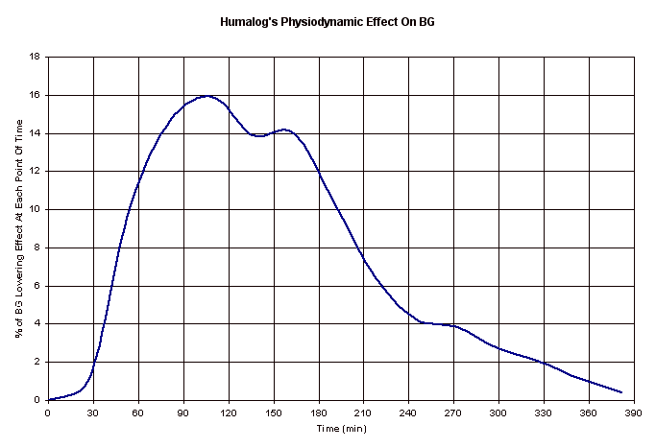
Duration Of Insulin Action (DIA)
Accurate boluses require an accurate DIA
DIA times shorter than 4.5 to 6 hrs hide BOB and its glucose lowering activity
Glucose-lowering Activity
0
2 hrs
4 hrs
6 hrs

Slide 55
Why A Short DIA Causes Problems
When the DIA time is set too short:
  Hidden bolus insulin makes the pump recommend boluses that are larger than really needed.
  People lower daytime basal rates because the basal seems excessive due to the hidden bolus insulin.
  Then the carb and correction factor numbers get lowered to offset the missing basal.
  The stronger carb and correction factors cause lows after high carb meals and higher than normal BGs
Example: if BG is 120 at bed with DIA at 3 hrs and a large bolus was taken 3 hrs before – it’s to go to sleep without a snack because there is no BOB and the basal gets blamed for the low that follows.

Slide 56
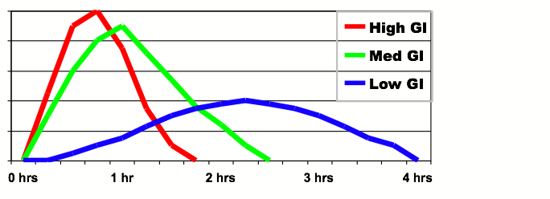
Duration Of Carb Action (Digestion)
Most carbs affect the BG only 1 to 2.5 hours
Slower digestion with complex carbs, more fiber, more fat, etc
BG impact varies considerably
Thanks to Gary Scheiner, MS, CDE

Slide 57
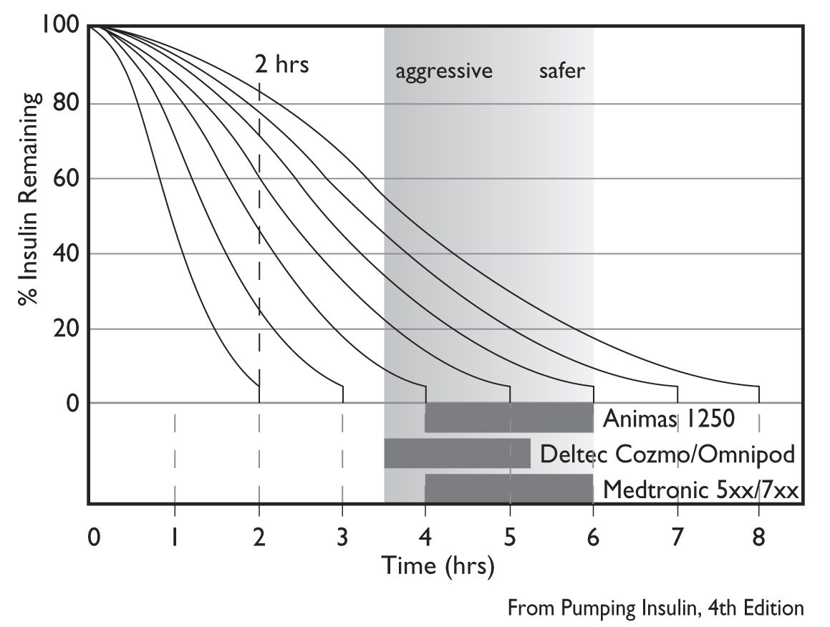
Recommended DIA Times
A DIA of 4.5 to 6 hrs makes BOB calculations more accurate.
DON’T reset your DIA without discussing this with your physician!
5 hr Linear
5 hr Curvilinear
From Pumping Insulin, 4th ed., adapted fom Mudaliar et al: Diabetes Care, 22: 1501, 1999

Slide 58
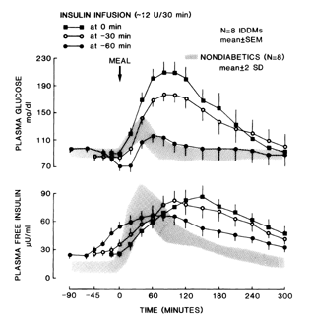
Bolus Early To Stop Meal Spikes
Figure shows rapid insulin injected 0, 30, or 60 min before a meal
Normal glucose and insulin profiles shown in the shaded areas
Best glucose profile when bolus is given 60 min ahead, but too risky to recommend!!!

Slide 59
DIA Tips
  DIA times don’t differ between children and adults
  Use of short DIA hides true BOB:
    Causes “unexplained” lows
    Leads to incorrect adjustments in basal rates, carb factors, and correction factors to compensate for excess boluses
    Makes user ignore their “smart” pump’s bolus recommendations
  If the pump does not “give enough bolus insulin”, look for real reason:
    A low TDD, low basal rates, or a carb factor number that’s too high
Don’t change DIA to fix control problems!

Slide 60
Where Are Pumps & CGMs Going?

Slide 61
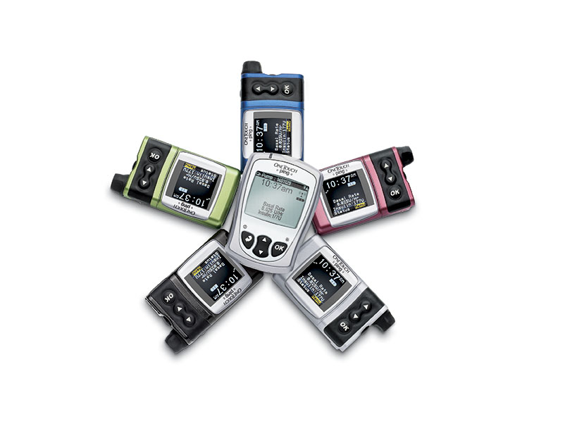
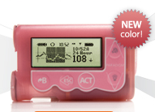
Cool Colors

Slide 62


Pump Styling
  Styling now competitive for pumps
  Don’t give up function/safety/ease-of-use for style

Slide 63
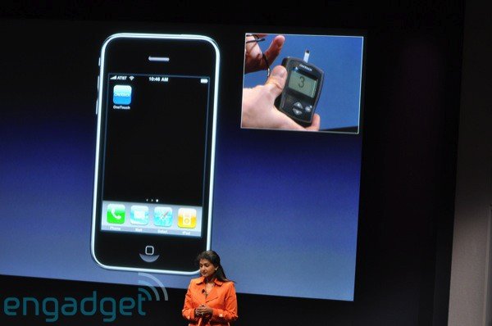
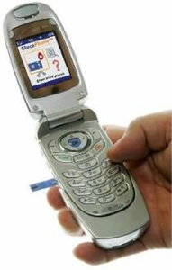


Communication – Pump + Phone
  Several companies are developing meters for phones using Bluetooth
  Rapid alerts for care-givers of young, elderly, hypo-unaware
  Adds food databases, carb counters, apps, analysis
  Eventually management via cell phone

Slide 64




Diabetes Phone Apps
  Wavesense Diabetes Manager, Gluco Buddy, Diabetes Log, Bant, Glucose Mate, Diabetic Meal Planner Lite
  Many apps available for I–Phones, Pre, Blackberry
  Help for dosing, logging, carb counting

Slide 65
Future Pump Features
  Show How Setting Changes Will Impact TDD & BG
  Temp Basal + Bolus Doses
  Super Bolus
  Meal Size Boluses
  Excess BOB Alert
  Exercise Compensator
  Infusion Set Monitor
  Automated Bolus and Basal Testing

Slide 66
Better Guidance From Smart Pumps
“Why can’t my smart pump learn?”
John Rodosevich, President of SD Pump Club
  Wanted: a pump that
  Recognizes glucose patterns
  Alerts user and provider about helpful basal or bolus setting adjustments
  Simplifies and speeds up data collection and its analysis
  Thinks and learns

Slide 67
Future Pump Modifications
  Smart phones integration that controls pump, shows sensor data, acts as BG meter, and analyzes data in a single device
  Smaller, flatter patch pumps with bolus buttons
  Dual chamber pumps – glucagon, amylin, or GLP-1 agonists along with insulin
  Better, more reliable infusion sets
  CGM integration into closed loop

Slide 68

How Long To A Closed Loop?
Still needed:
  Faster insulins
  Better CGM accuracy
  Less sensor lag time
Dual pumps with glucagon
Glucose control algorithms that don’t fail

Slide 69



Reading – Still The Best Way To Learn
www.diabetesnet.com or 800-988-4772

